Slide 1


HR DATA ANALYSIS
by Yashika Gupta

Slide 2
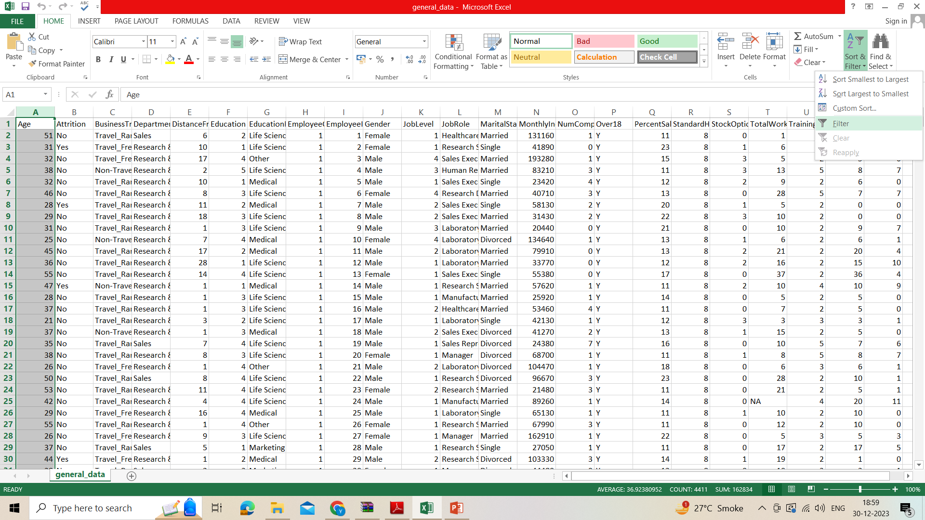
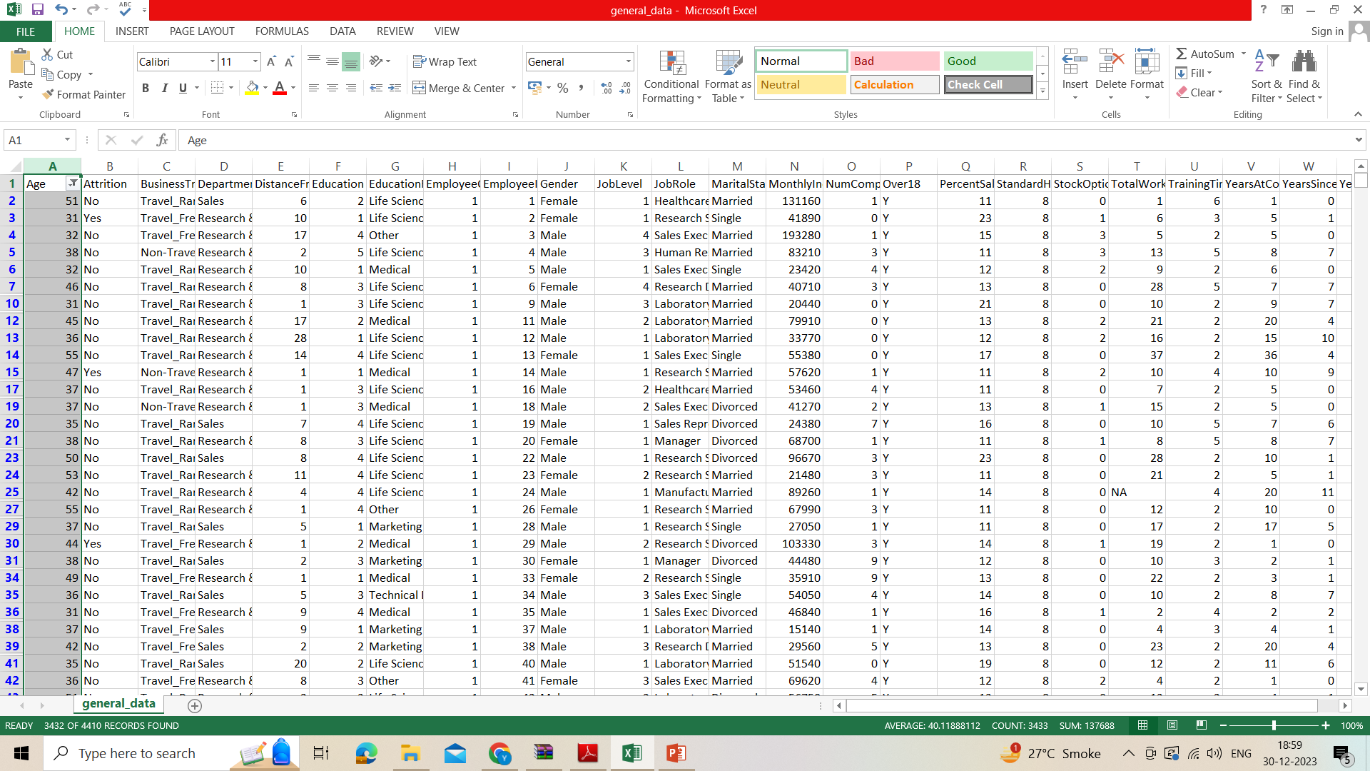
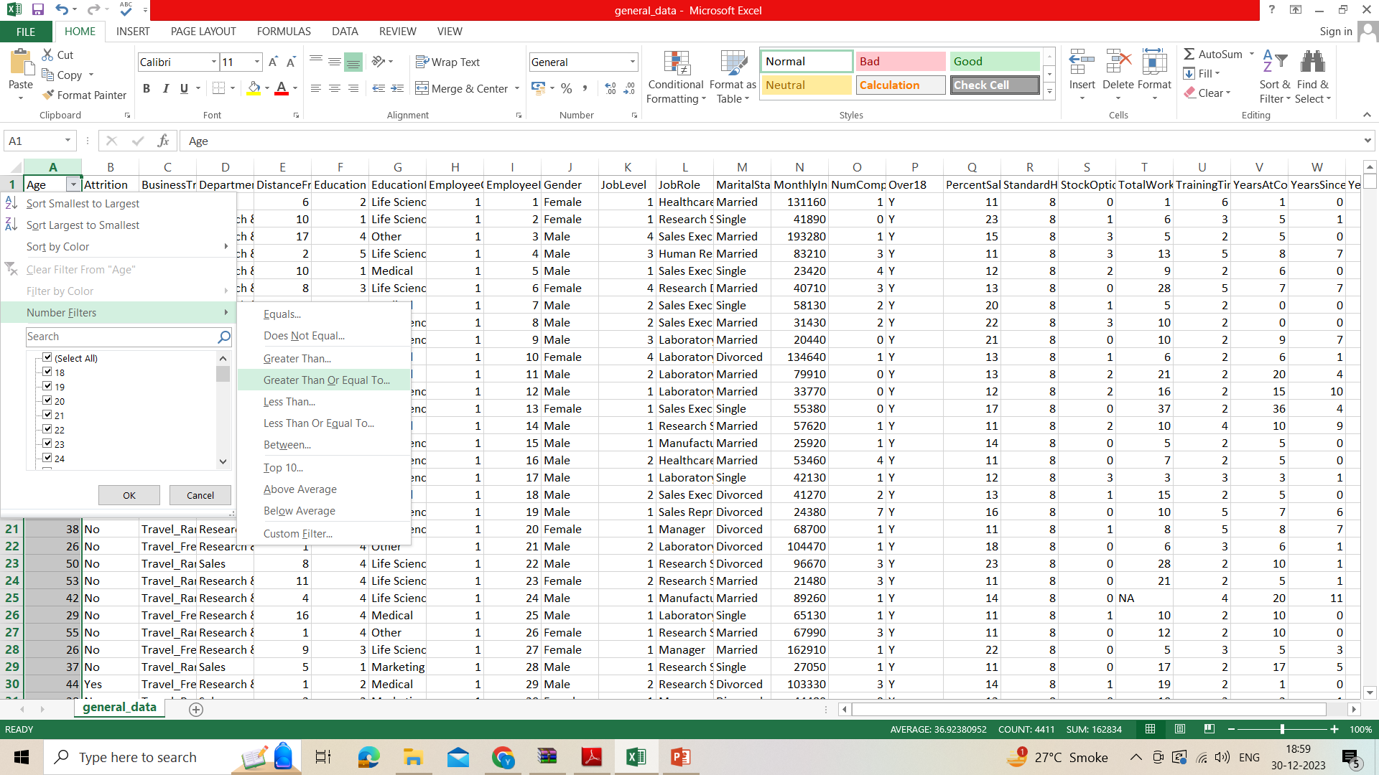
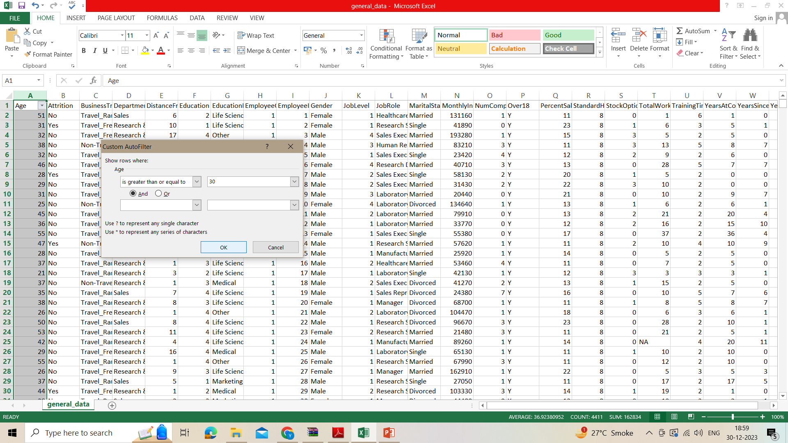
1. Using Excel, how would you filter the dataset to only show employees aged 30 and above?

Slide 3
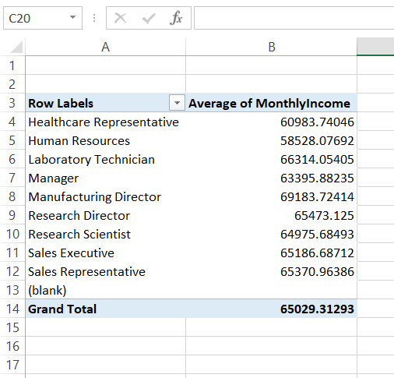
2. Create a pivot table to summarize the average Monthly Income by Job Role.

Slide 4
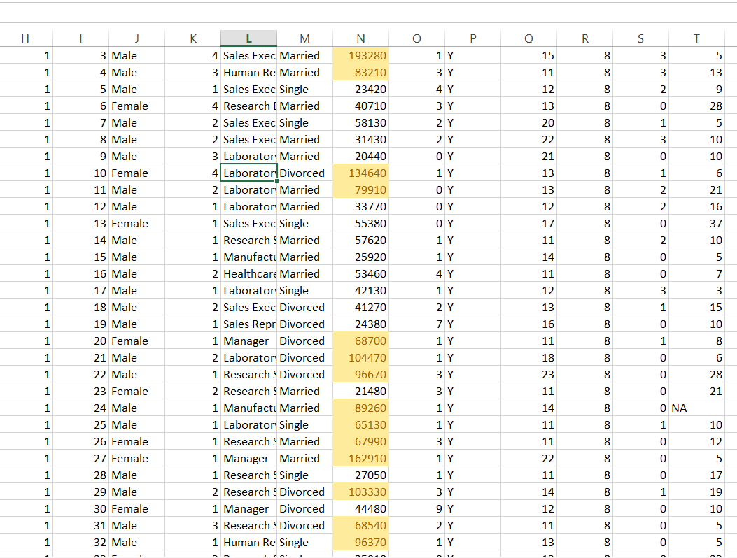
3. Apply conditional formatting to highlight employees with Monthly Income above the company's average income.

Slide 5
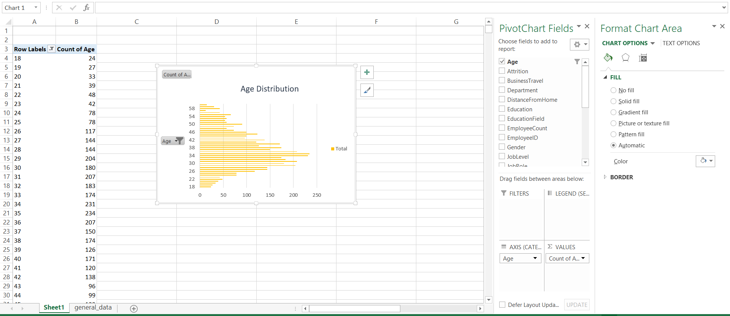
4. Create a bar chart in Excel to visualize the distribution of employee ages.

Slide 6
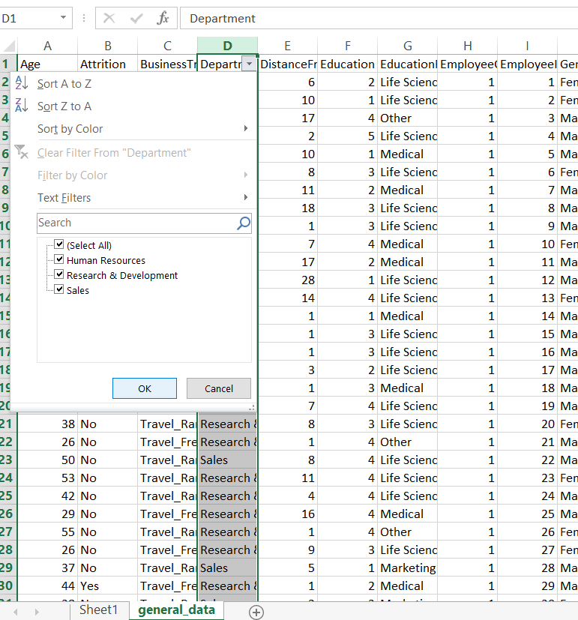
5. Identify and clean any missing or inconsistent data in the "Department" column.
Result:
There is no inconsistent data.

Slide 7
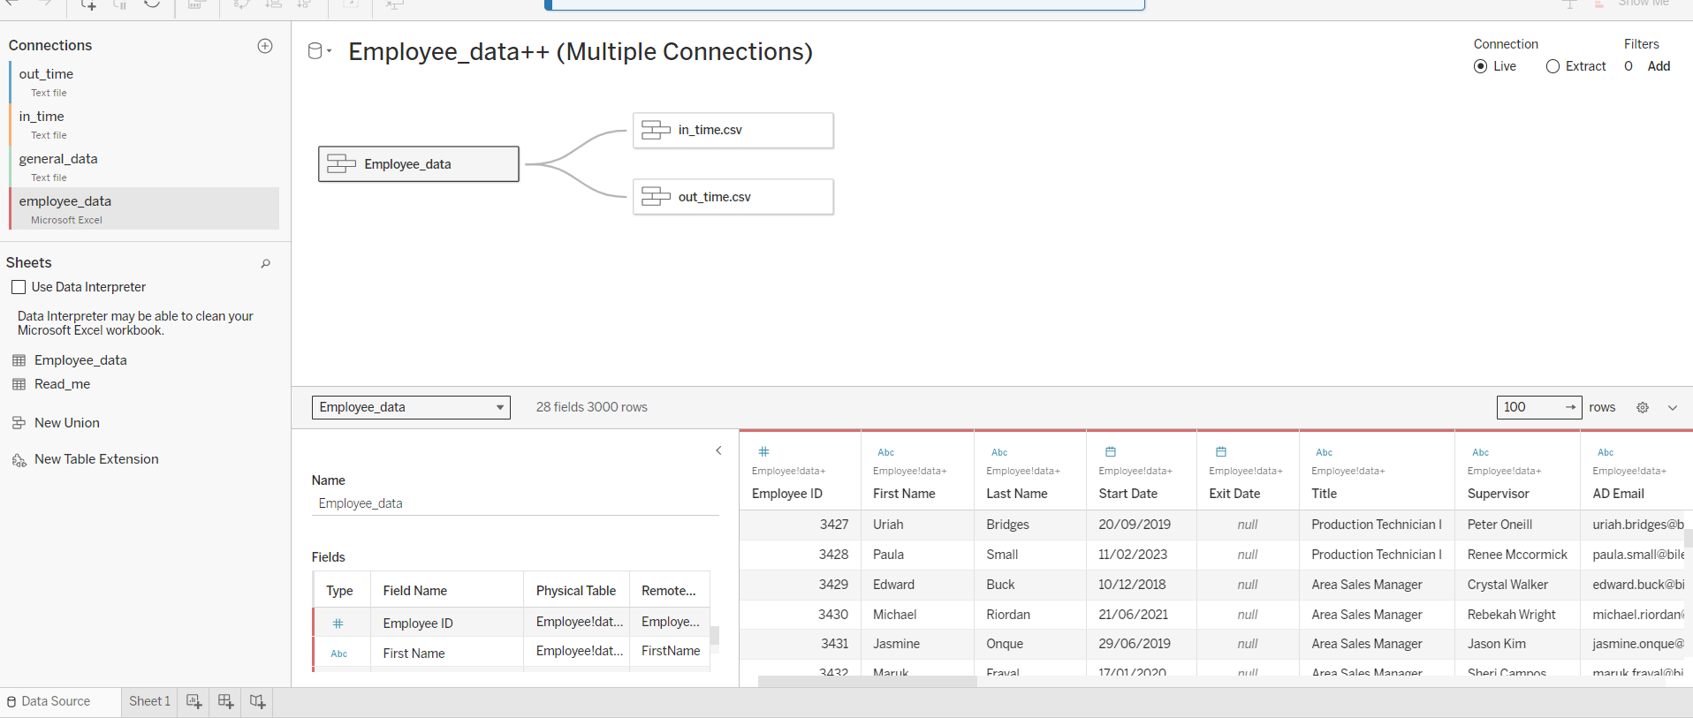
6. In Tableau, establish a relationship between the "EmployeeID" in the employee data and the "EmployeeID" in the time tracking data.

Slide 8
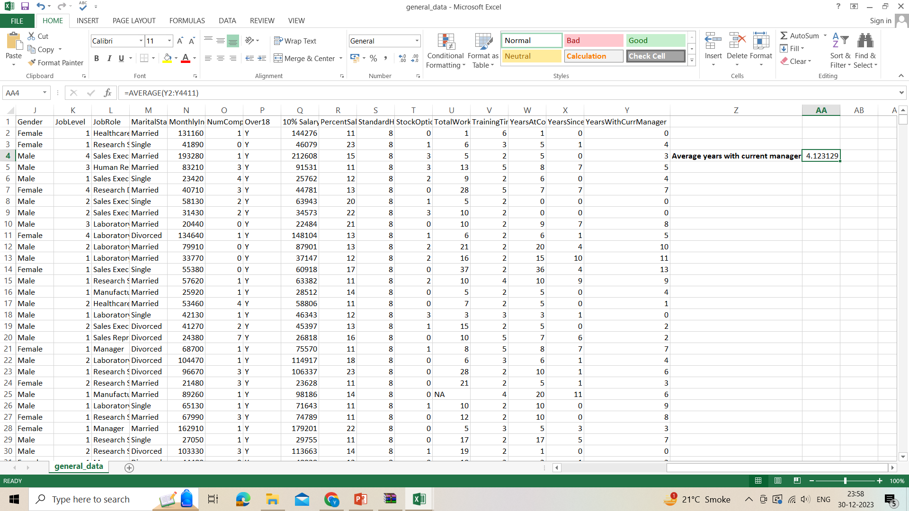
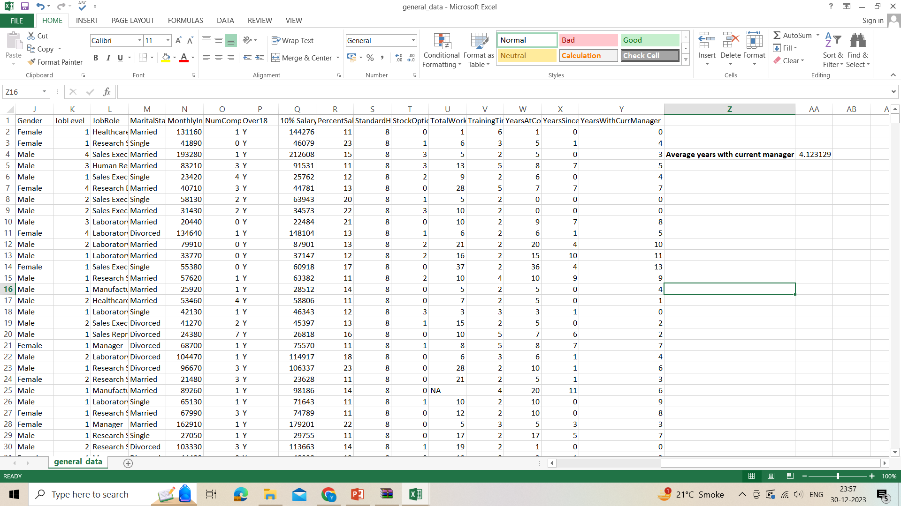
7. create a calculated column that calculates the average years an employee has spent with their current manager.

Slide 9
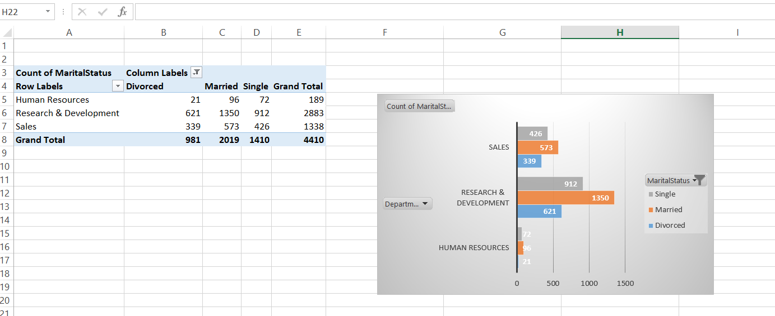
8. Using Excel, create a pivot table that displays the count of employees in each Marital Status category, segmented by Department.

Slide 10
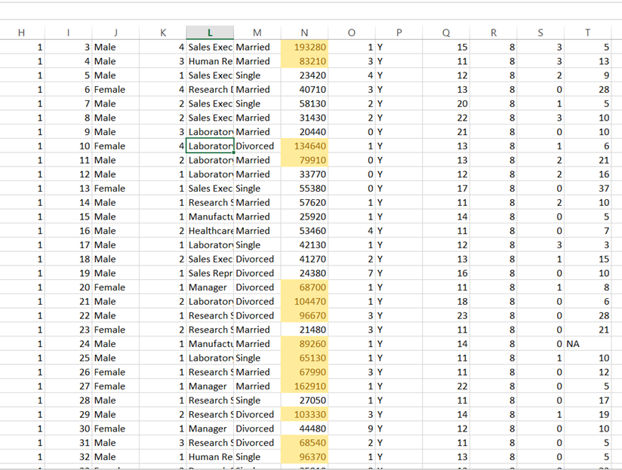
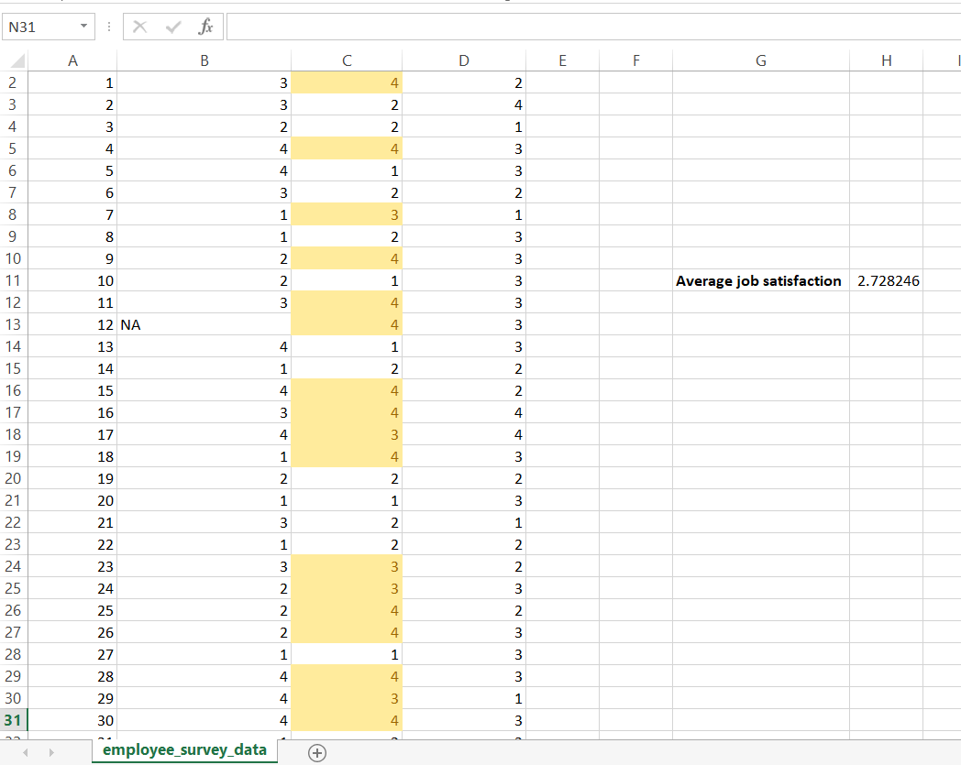
9. Apply conditional formatting to highlight employees with both above-average Monthly Income and above-average Job Satisfaction.

Slide 11
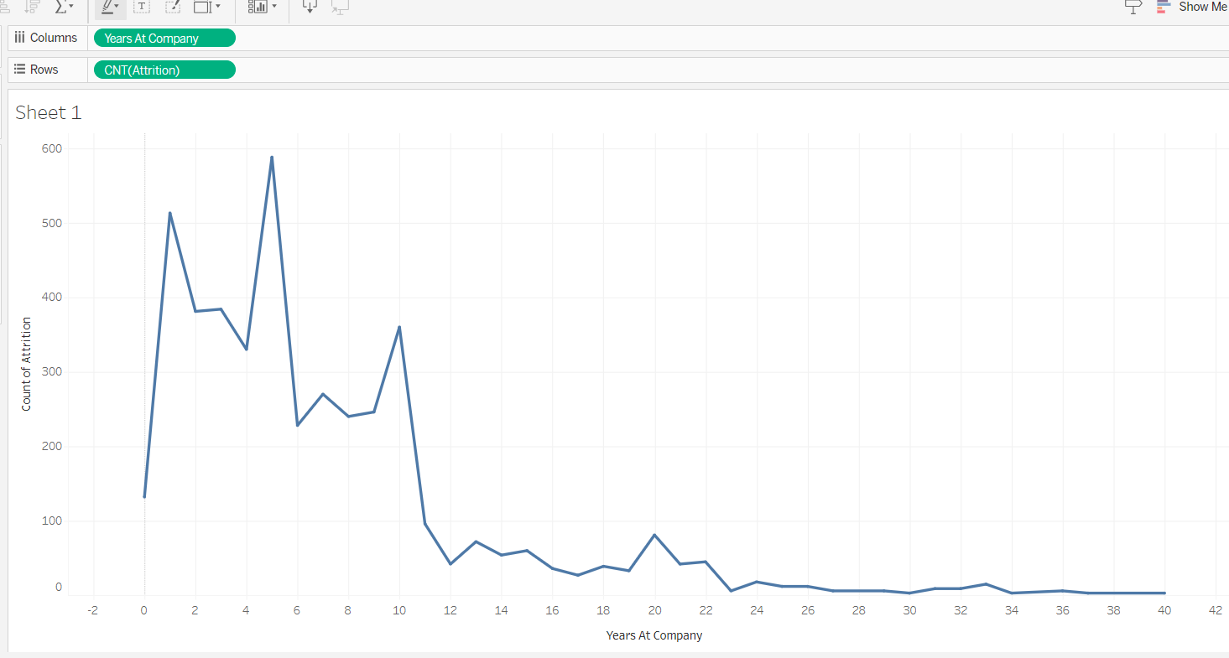
10. In Tableau, create a line chart that visualizes the trend of Employee Attrition over the years.

Slide 12
11. Describe how you would create a star schema for this dataset, explaining the benefits of doing so.
A star schema is a type of data warehouse schema that's designed to make it easy to analyze large amounts of data. It's named after the star-like shape it forms in a visual representation, with a central fact table surrounded by smaller dimension tables.
Here are the key components of a star schema:
Fact table: This table sits at the center of the star and contains the quantitative data or "facts" about your business, such as sales figures, website traffic, or customer transactions.
Dimension tables: These tables radiate out from the fact table and contain descriptive attributes that provide context for the facts, such as product information, customer demographics, or time periods.
Benefits of using a star schema:
Simple and easy to understand: The star-like structure makes it easy to visualize the relationships between data points.
Fast query performance: Because dimension tables are denormalized (meaning they contain repeated data), queries that aggregate data across dimensions can be performed quickly.
Good for OLAP (online analytical processing): Star schemas are well-suited for tasks like slicing and dicing data to analyze trends and answer business questions.
Flexible and scalable: You can easily add new dimension tables to the schema as needed

Slide 13
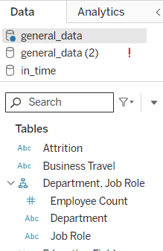
12. Create a hierarchy in Power BI that allows users to drill down from Department to Job Role to further narrow their analysis.

Slide 14
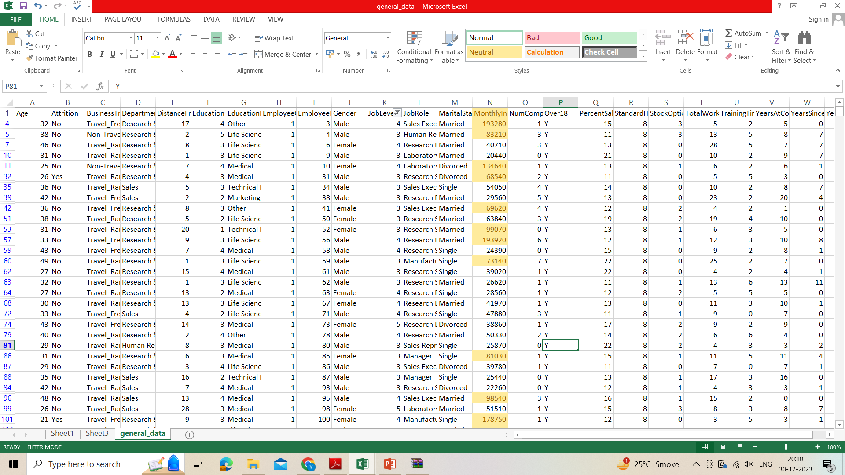
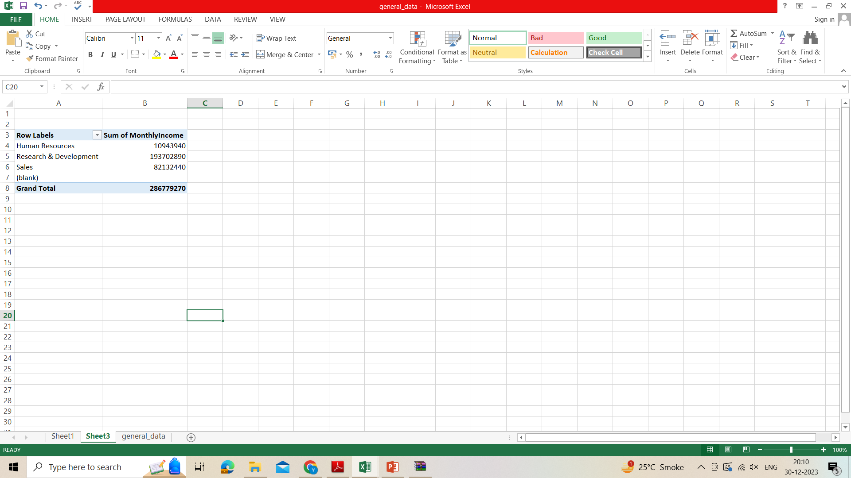
13. In Excel, calculate the total Monthly Income for each Department, considering only the employees with a Job Level greater than or equal to 3.

Slide 15
14. Verify if the data adheres to a predefined schema. What actions would you take if you find inconsistencies?
1. Obtain the Schema:
Acquire a clear understanding of the expected structure and format of the data, including:
Table and column names
Data types (e.g., numbers, text, dates)
Constraints (e.g., required fields, unique values, value ranges)
2. Inspect Data:
Employ visual checks (e.g., sample rows, data profiling tools) to identify potential inconsistencies.
Use data profiling tools to visualize data distributions, identify missing values, outliers, and unexpected patterns.
3. Perform Data Validation:
Implement automated validation checks:
Data types match the schema.
Required fields have values.
Values fall within expected ranges.
Unique constraints are met.
Utilize data validation tools or libraries within your programming language or data processing framework.

Slide 16
4. Address Inconsistencies:
Correct at the Source: If possible, rectify issues at the data origin to prevent future occurrences.
Cleanse Data: If corrections at the source are infeasible, employ data cleaning techniques:
Fill missing values (e.g., with defaults, imputation methods).
Correct data types.
Adjust values to conform to constraints.
Remove or isolate problematic records.
Document Issues: Maintain a record of inconsistencies, actions taken, and justifications for decisions.
5. Monitor Data Quality:
Implement ongoing data quality monitoring processes to detect and address inconsistencies early.
Utilize data quality dashboards and alerts.

Slide 17
Thank You

